Slide 1
Estimating Time and Location from solar shadows
- Krishna G

Slide 2
Introduction
The market for using unmanned aerial vehicles (UAV) to inspect the utility transmission and distribution infrastructure is expected to reach $4.1B annually by 2024.
Current civilian / commercial UAV’s are vulnerable to many attacks, out of which GPS spoofing, GPS Jamming, Video Replay Attack, DeAuth Attack being a few.
There’s been a lot of research around detection / prevention of most of them. But, attacks related to video system are less researched.
If UAV’s are cyber attacked, there is a chance that Video Replay Attack is performed. There are no ways to detect it.
In this project, I used Solar shadows of poles to estimate location and time.

Slide 3
Related Work
Junejo, Imran N., and Hassan Foroosh. "GPS coordinates estimation and camera calibration from solar shadows." Computer Vision and Image Understanding 114.9 (2010): 991-1003.
The above paper implemented the use of shadows, to geo-locate static cameras.
This project aim is to implement it and extend it to UAV footage.

Slide 4
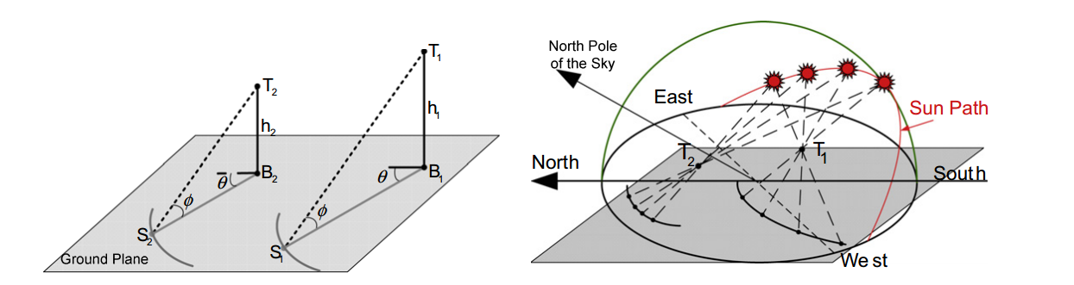
Theory
Relatively sun moves 1⁰ for approximately 4 minutes w.r.t earth
For a single frame altitude angle of sun can be calculated, but its not enough to determine time (it might be on either side) and loc.
Two frames, that can be used to differentiate the change by a significant amount will be able to determine time, but not location.
We need at least 3 frames to determine location. More frames would reduce the noise effect and make it robust.

Slide 5
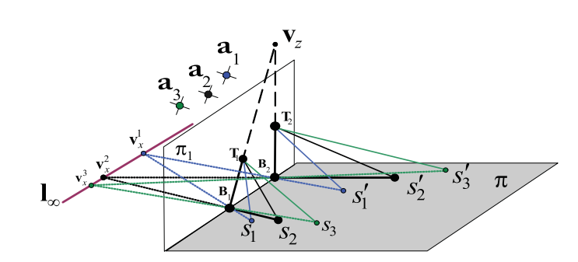
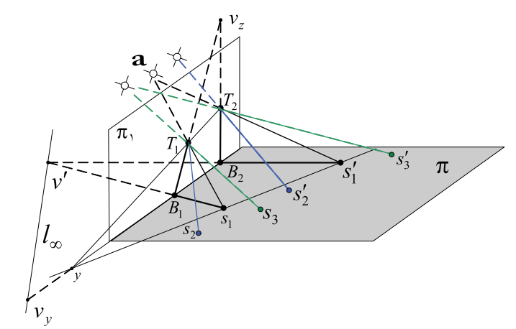
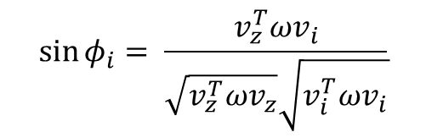
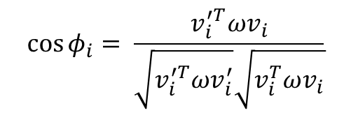
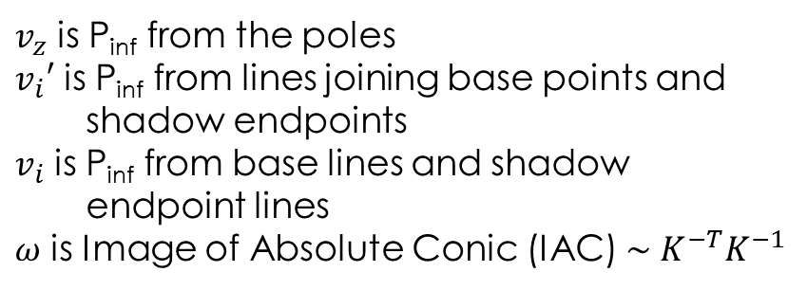
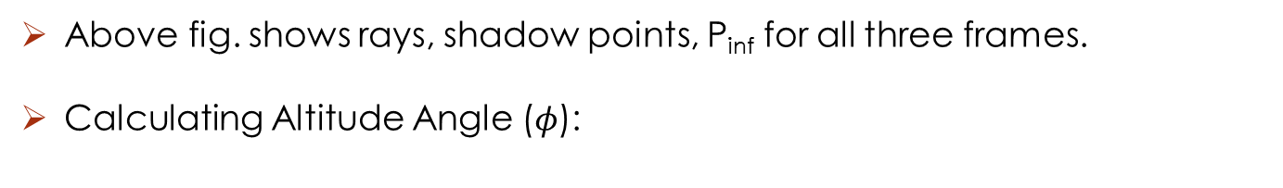
Theory
Above fig. shows rays, shadow points, P_{inf} for all three frames.
Calculating Altitude Angle ($φ$):
$$\cos{φ_{i}= \frac{v_{i}^{′T}ωv_{i}}{\sqrt{v_{i}^{′T}ωv_{i}^{′}}\sqrt{v_{i}^{T}ωv_{i}}}}$$
$v_{z}$ is P_{inf} from the poles
$v_{i}′$ is P_{inf} from lines joining base points and shadow endpoints
$v_{i}$ is P_{inf} from base lines and shadow endpoint lines
$ω$ is Image of Absolute Conic (IAC) $\sim K^{−T}K^{−1}$
$$\sin{φ_{i}= \frac{v_{z}^{T}ωv_{i}}{\sqrt{v_{z}^{T}ωv_{z}}\sqrt{v_{i}^{T}ωv_{i}}}}$$

Slide 6
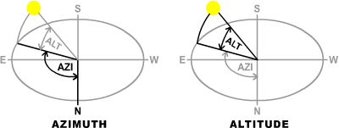
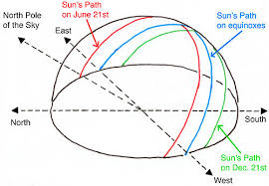
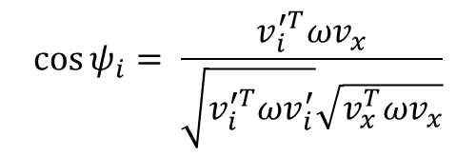
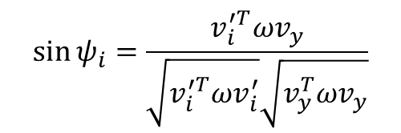
Theory
Calculation Time:
Altitude angle ranges from
0 (Sun rise) -> 180 (Sun set)
Dividing the angles into segments and finding the segment to the angle found earlier. From the choices, select the time based on the shift.
Calculating azimuth angle ($ψ$):
$$\cos{ψ_{i}= \frac{v_{i}^{′T}ωv_{x}}{\sqrt{v_{i}^{′T}ωv_{i}^{′}}\sqrt{v_{x}^{T}ωv_{x}}}}$$
Where $v_{x}$ and $v_{y}$ are vanishing points
$$\sin{ψ_{i}=\frac{v_{i}^{′T}ωv_{y}}{\sqrt{v_{i}^{′T}ωv_{i}^{′}}\sqrt{v_{y}^{T}ωv_{y}}}}$$

Slide 7
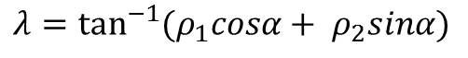
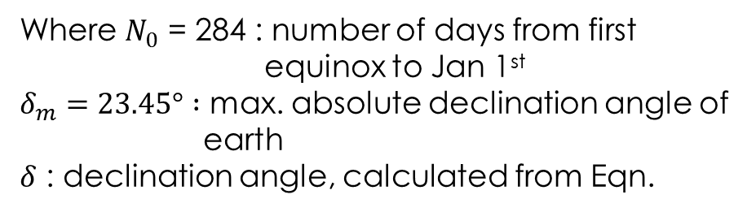
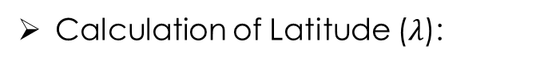
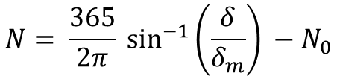
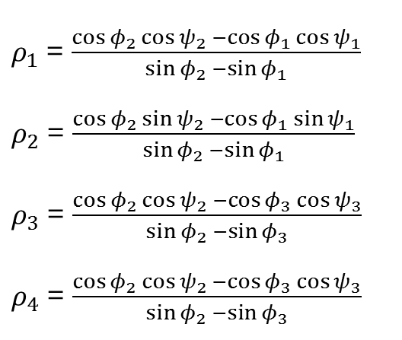
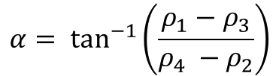
Theory
Calculation of Latitude ($λ$):
$ρ_{1}$ = $\frac{\cos{φ_{2}}\cos{ψ_{2} −\cos{φ_{1}}\cos{ψ_{1}}}}{\sin{φ_{2}} −\sin{φ_{1}}}$
$ρ_{2}$ = $\frac{\cos{φ_{2}}\sin{ψ_{2} −\cos{φ_{1}}\sin{ψ_{1}}}}{\sin{φ_{2}} −\sin{φ_{1}}}$
$ρ_{3}$ = $\frac{\cos{φ_{2}}\cos{ψ_{2} −\cos{φ_{3}}\cos{ψ_{3}}}}{\sin{φ_{2}} −\sin{φ_{3}}}$
$ρ_{4}$ = $\frac{\cos{φ_{2}}\cos{ψ_{2} −\cos{φ_{3}}\cos{ψ_{3}}}}{\sin{φ_{2}} −\sin{φ_{3}}}$
$$λ=\tan^{−1}{(ρ_{1}cosα+ ρ_{2}sinα)}$$
Where
$$α= \tan^{−1}\left(\frac{ρ_{1}−ρ_{3}}{ρ_{4} −ρ_{2}}\right)$$
and
Calculating Day Number:
$$N= \frac{365}{2π} \sin^{−1}\left(\frac{δ}{δ_{m}}\right) −N_{0}$$
Where $N_{0}$ = 284 : number of days from first equinox to Jan 1st
$δ_{m}=23.45° :$ max. absolute declination angle of earth
$δ$ : declination angle, calculated from Eqn.
$${(sinδ )}^{2} − 2 ∗sinλ∗sinδ+{(cosλ)}^{2}∗({(cosφsinθ)}^{2}−1)+ {(sinφ)}^{2}=0$$

Slide 8
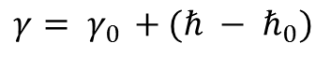
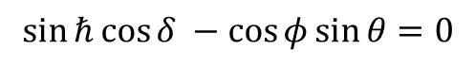
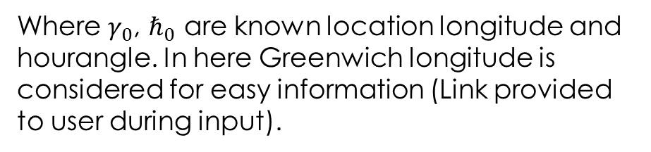
Theory
Calculating longitude($γ$):
$$γ= γ_{0 }+(ℏ − ℏ_{0})$$
Where $γ_{0}$, $ℏ_{0}$ are known location longitude and hourangle. In here Greenwich longitude is considered for easy information (Link provided to user during input).
$ℏ$ is the local hour angle, can be calculated from equation
$$\sin{ℏ}\cos{δ} −\cos{φ}\sin{θ}=0$$

Slide 9
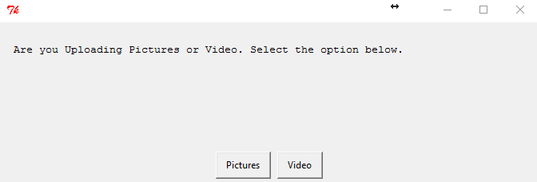
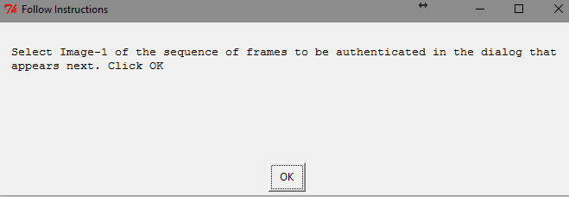
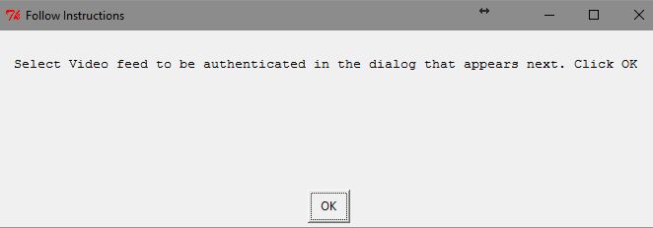
Implementation
It has been implemented as a system, that prompts step-by-step instructions to user. On running, a prompt will be shown for user to select.
Pictures
Video
After converting video to frames
Location saved will be shown in a GUI before selection

Slide 10
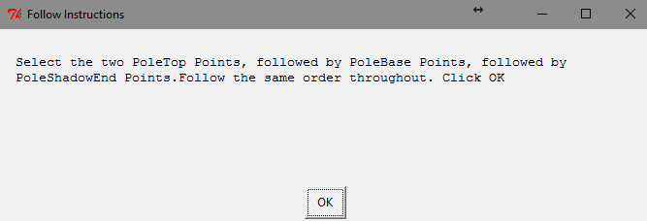
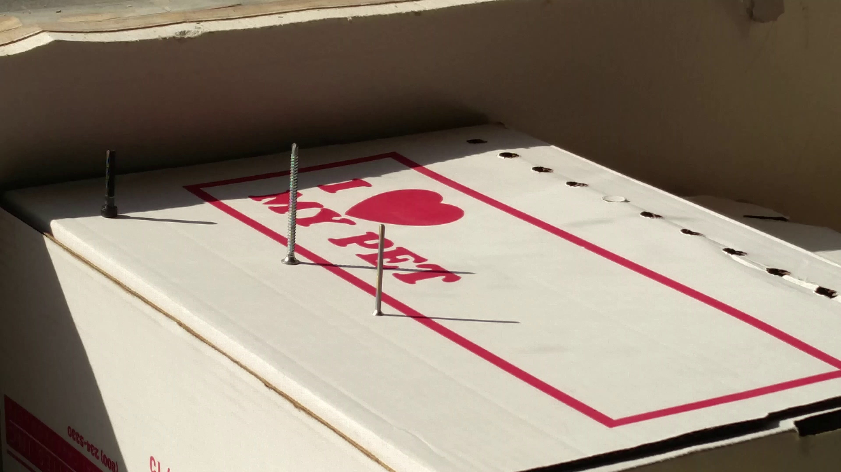

Implementation
After selecting three images
Select points (MouseClick and ‘b’ after done)

Slide 11
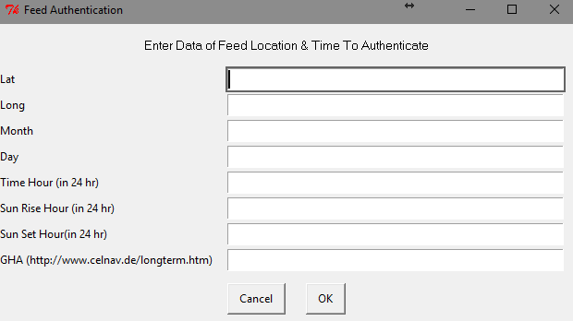
Implementation
Result will be shown
User Input: ['30.618980', '-96.338946', '5', '6', ’16.8', '6.5', '20', '75']
34.0467033927 -107.679037278 2017-04-22 17.290372062

Slide 12
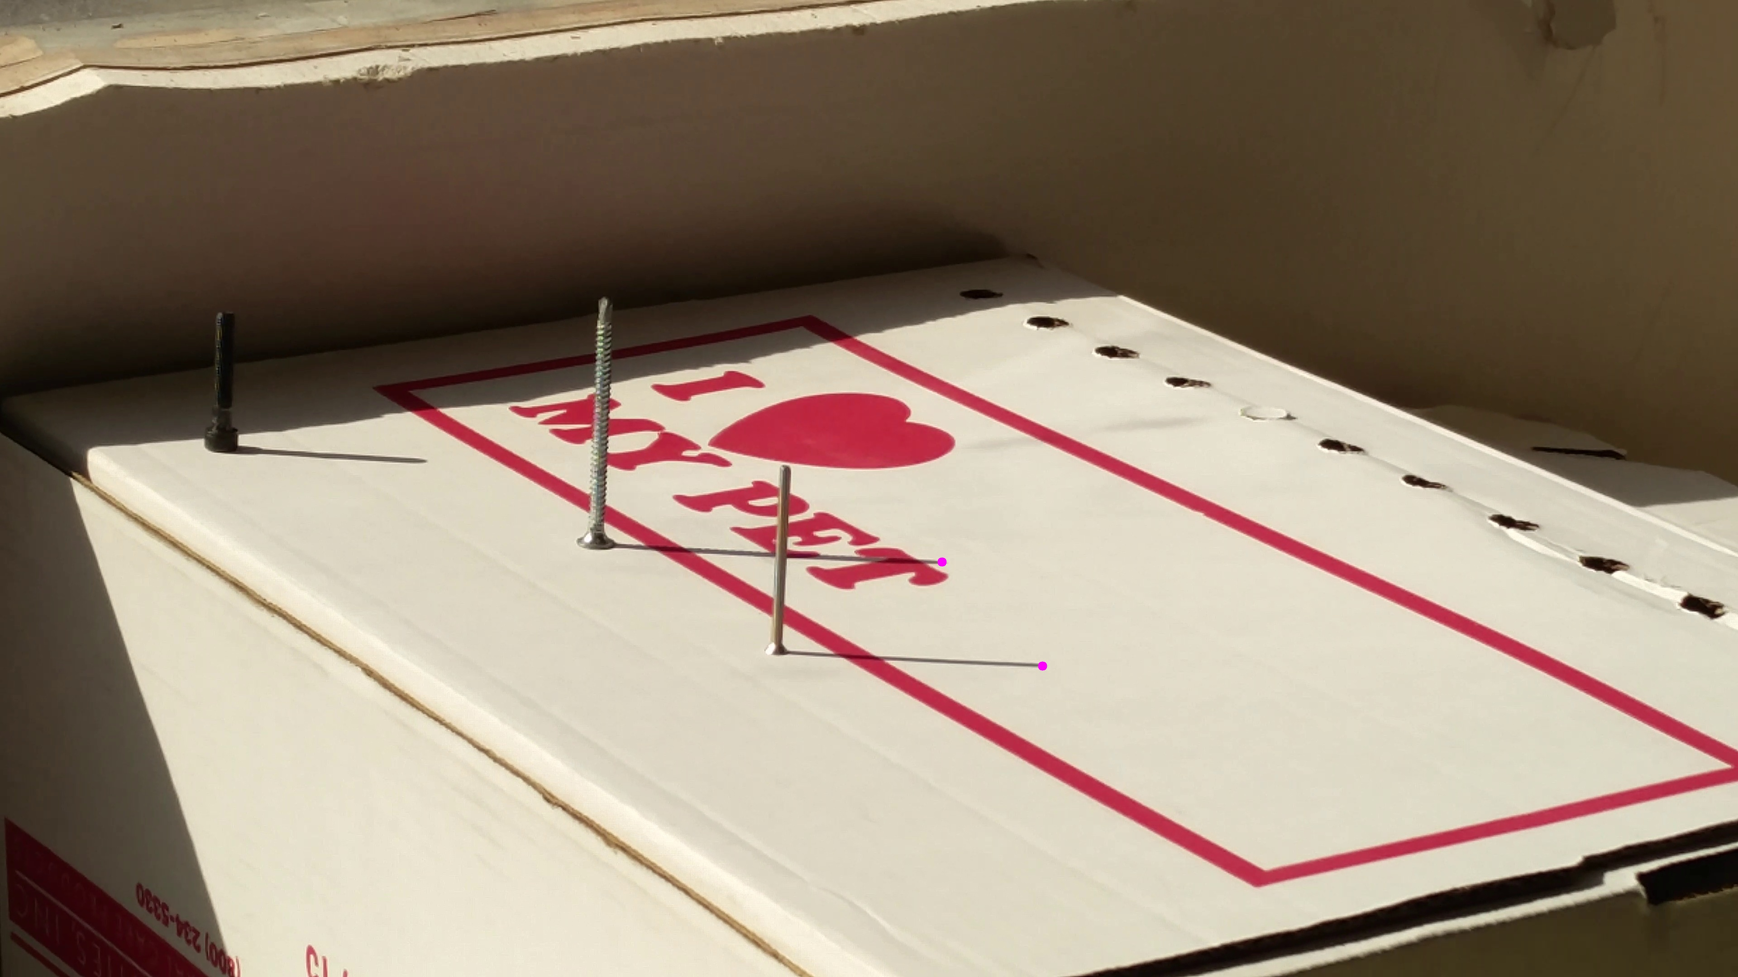
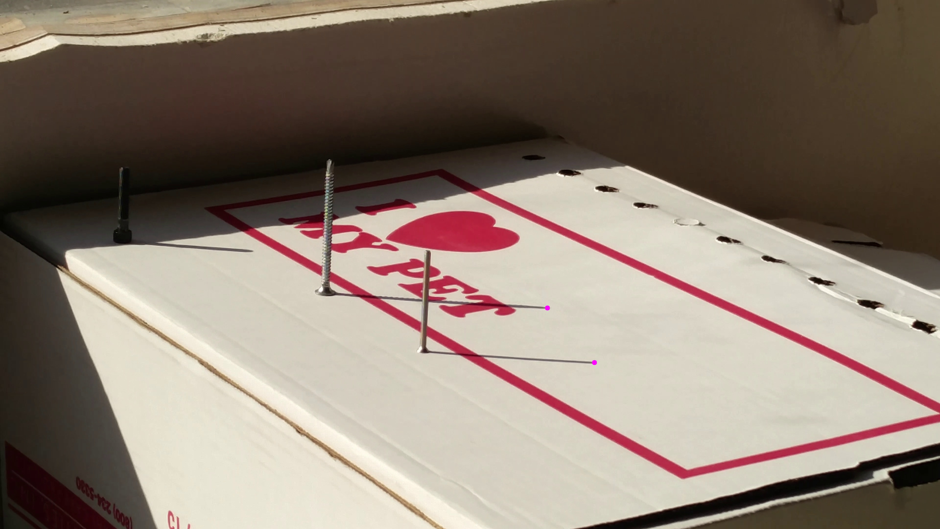
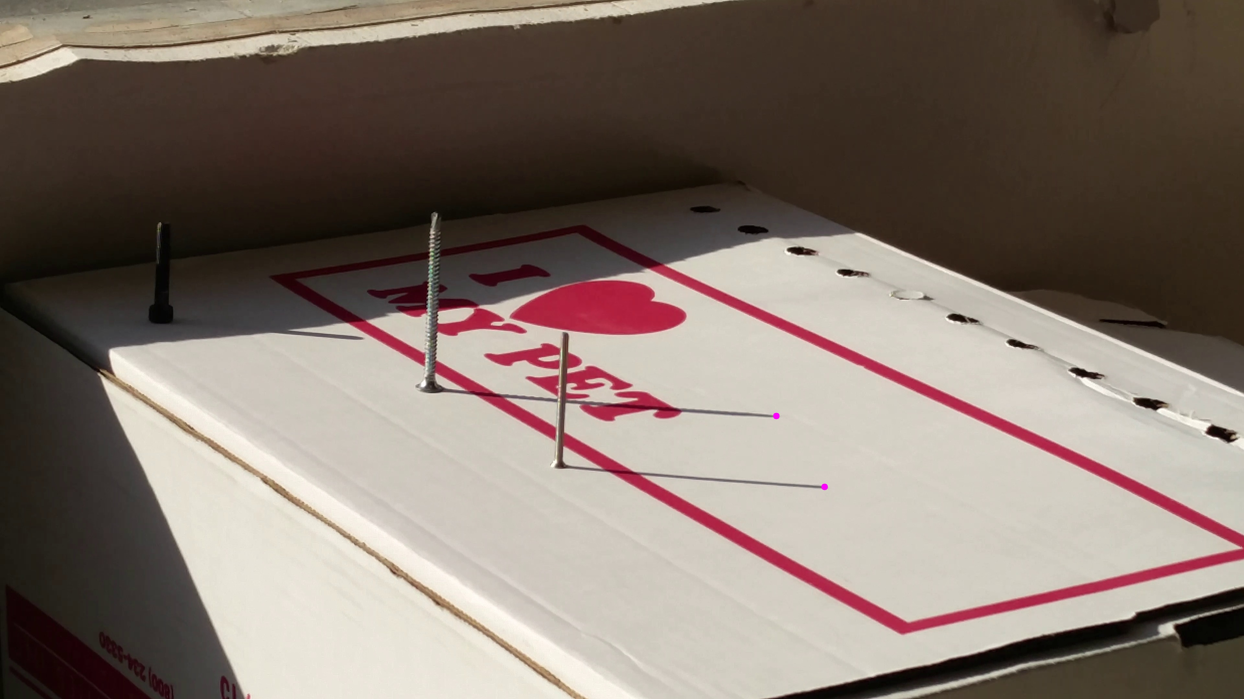
Results
User Input: ['30.618980', '-96.338946', '5', '6', ’16.8', '6.5', '20', '75']
34.0467033927 -107.679037278 2017-04-22 17.290372062
36.3358702944 -106.615763538 2017-04-25 17.1387713033
44.7230300356 -129.219302294 2017-04-10 17.332688675
These images are frames from the video taken by using an app @ 1 frame / min

Slide 13
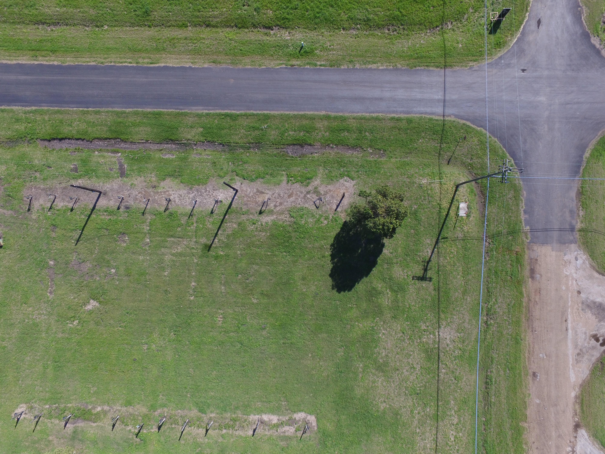

Results
Modified the original to create another system to just determine time.
User Input: ['10.5', '7.5', '19.5']
9.4573336891
15.0067650854
Single Image is not sufficient to know time, it can be either

Slide 14
Advantages
Does not disrupt the inspection of UAV.
Case 1: Old video
Case 2: Different place video: Location with 3

Slide 15
Disadvantages
No year
Need Sun. Does not work in cloudy days, night

Slide 16
Conclusion
Flight time of an UAV is around 30 min. (DJI Phantom 3 – 25 min)
The images that can be analyzed should be at least 4-5 min apart -> 12-15 min of static video from the UAV.
Using most of the flight time to authenticate the feed is not an optimum way of using resources.
Video stabilization cannot be applied, since it might crop the original size of the image.
Homography might not help, since there is a chance that it might rectify shadow the wrong way.
In conclusion, this implementation is not reliable and optimum way to authenticate the feed.

